Slide 1
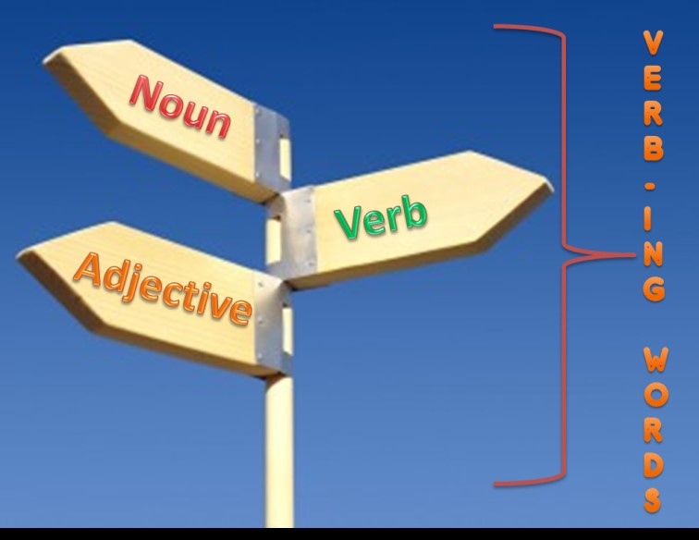
Functions of a Gerund
English VI

Slide 2
Verb
Noun
Adjective
A word that DESCRIBES A NOUN or pronoun. It normally indicates quality, size, shape, duration, feelings, contents, and more about a noun or pronoun.
It is a word that refers to persons, animals, places, things, ideas, or events, etc
It refers to the ACTION of the sentence.

Slide 3
Verb
Noun
Adjective
I am growing beautiful roses in my garden.
The man climbing the Everest is famous.
My colleagues are all smoking outside.
The students are writing their thesis in different parts.
I was reading a chapter of my new book.
Growing plants is my hobby.
Climbing can be dangerous.
Smoking costs a lot of money.
I don't like writing.
My favorite occupation is reading.
My climbing boots are in Anthony’s house.
This is not a smoking area, please do not smoke.
I am scared of the writing test, I hope I do well.
I have to finish my reading lesson before class.

Slide 4
You should make a wish when you see a falling star.
Eating people is wrong.
Did you read that amazing book?
Have you read any interesting books lately?
She has been walking 1 hours daily.
This movie is so exciting!
Walking is good for you.
Omg! I can’t believe he is cheating on her!
His economics class is boring.
Your knitting is beautiful.
Cafeteria food tastes disgusting.
Adjective
Noun
Adjective
Adjective
Verb
Adjective
Noun
Verb
Adjective
Noun
Adjective

Slide 5
Our last meeting was not very productive.
The man was calling his friend, when the lights went out.
That is a very nice painting.
After a slow beginning, the show got a bit more lively.
Taking too many aspirins is dangerous.
I am giving Sally a driving lesson.
That’s what I’ve been saying all along.
You don’t have to hide your feelings
The children can be really annoying.
The boiling water on the stove is hot.
The water has been boiling for 10 minutes already.

Slide 6
PRESENT CONTINUOUS
I AM LISTENING.
PAST CONTINUOUS
I WAS/WERE LISTENING
PRESENT PERFECT CONTINUOUS
I HAVE BEEN LISTENING TO THE TEACHER.
FUTURE CONTINUOUS
I WILL BE WORKING AS AN ENGINEER.

Slide 7
SOURCES
https://www.englishclub.com/grammar/verbs-ing-form.htm
https://medium.com/@engtuto1/can-gerunds-be-also-used-as-adjectives-89e5698411f3#:~:text=For%20example%2C%20in%20the%20phrase,doing%20the%20action%20of%20swimming.
https://www.ef.com/wwen/english-resources/english-grammar/ing-forms/
https://e-gmat.com/blogs/functions-verbing-gmat-verbal/
https://www.youtube.com/watch?v=yRVbMUkTlzI (video of gerund used as a noun)
https://www.youtube.com/watch?v=1SjKuj18668 (Video of gerund as noun, adjective and verb)

